Slide 1
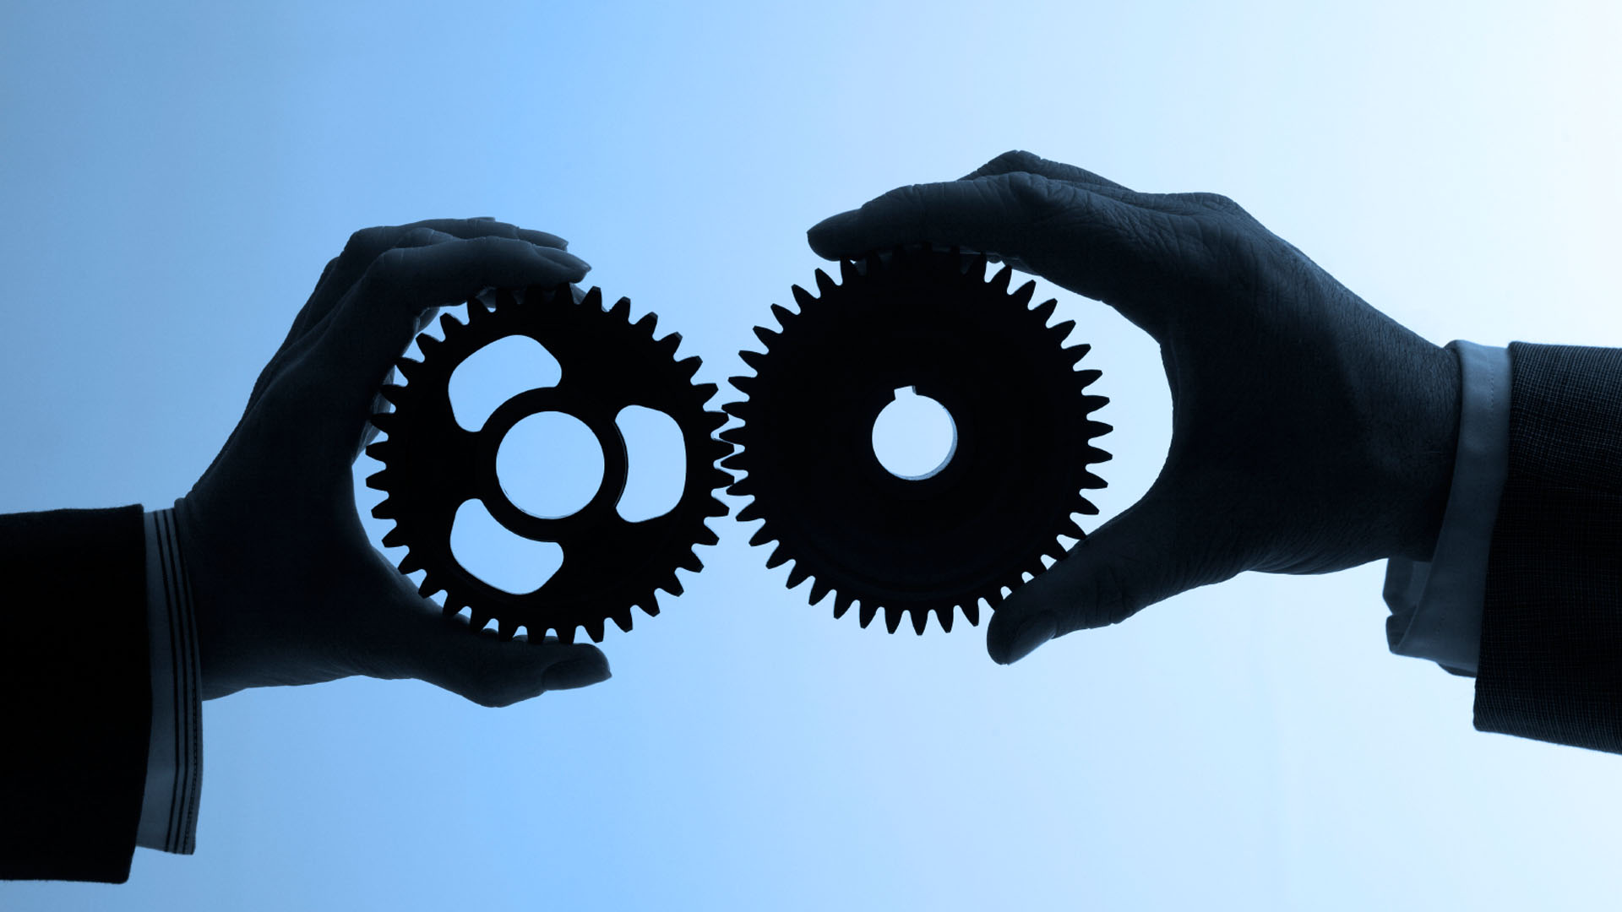
Mobile Human Computer Interaction I
Text input for single-handed mobile devices
Johann Albach, Sebastian Hartwig, Kaith Menken, Daniel Eischer

Slide 2
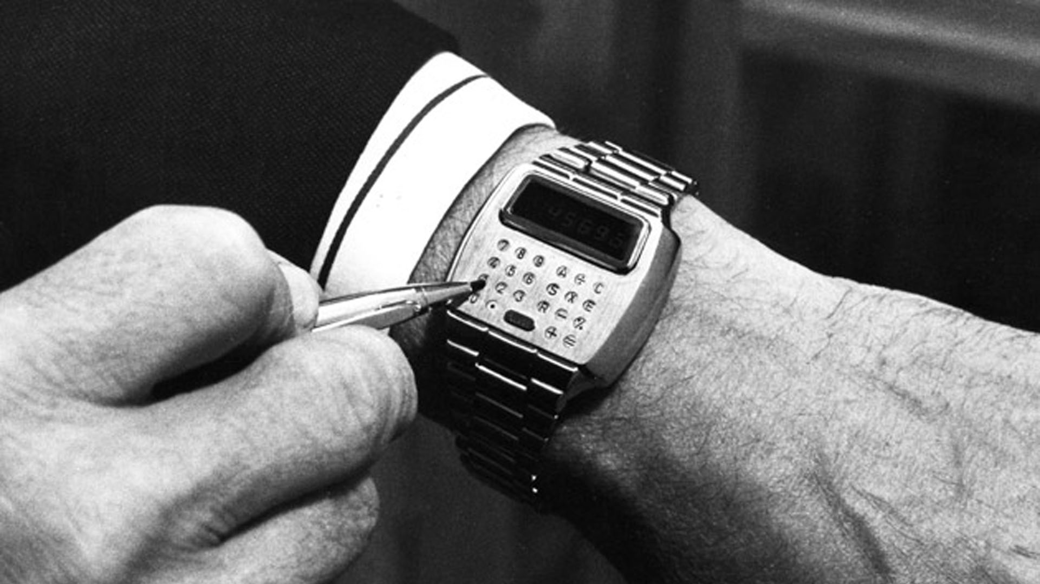
Technologie yesterday - calulator watch

Slide 3
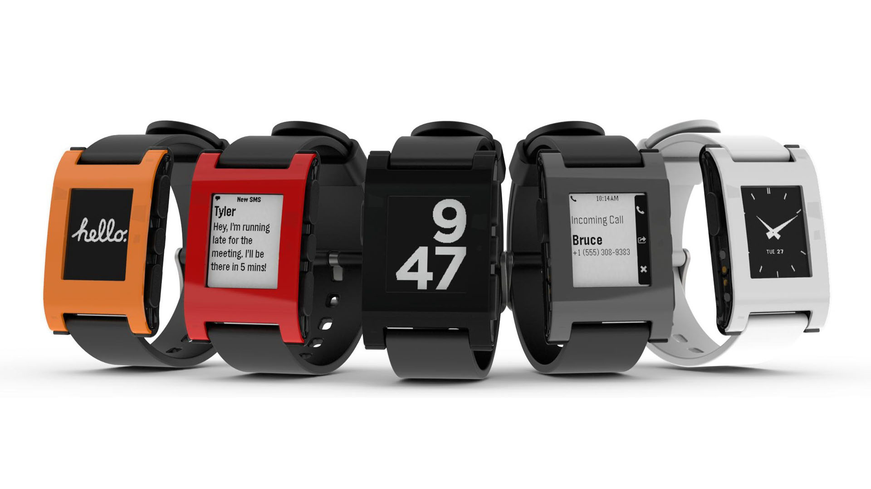
Technologie today - Pebble Smartwatch

Slide 4
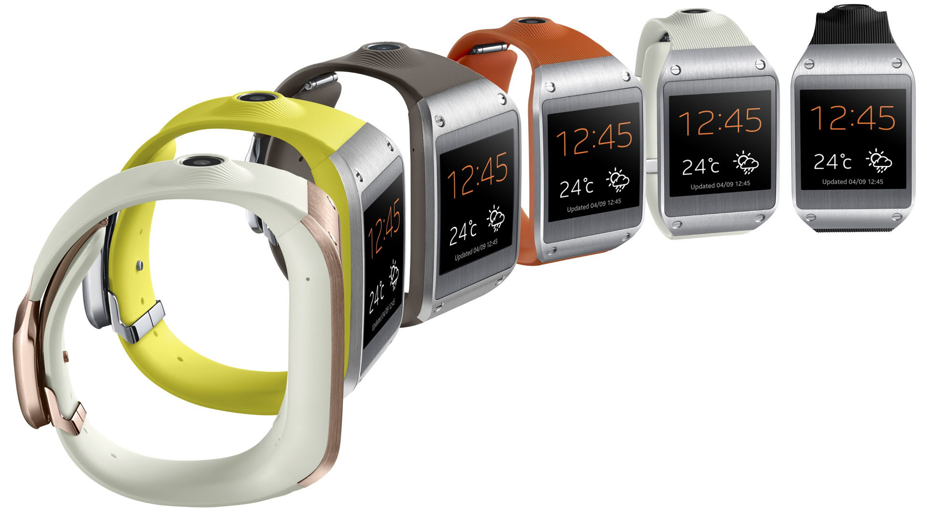
Technologie today – Samsung Galaxy Gear

Slide 5
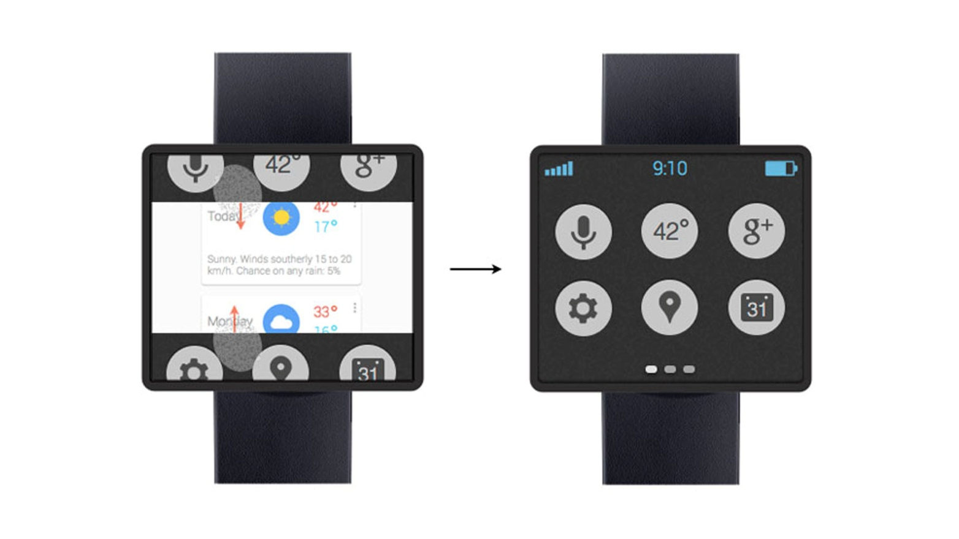
A glimpse into the future

Slide 6
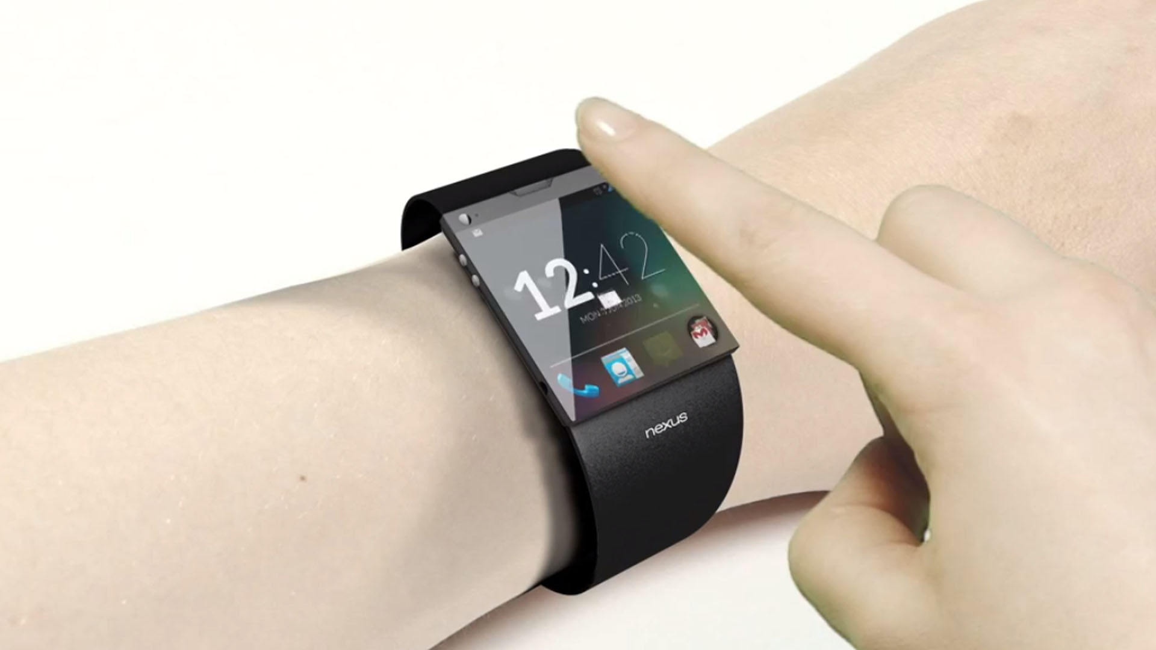
A glimpse into the future

Slide 7
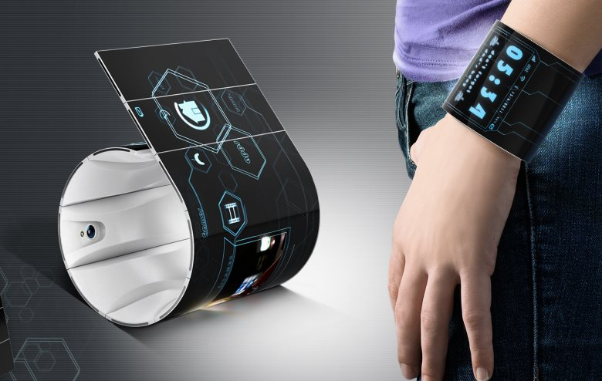
A glimpse into the future

Slide 8
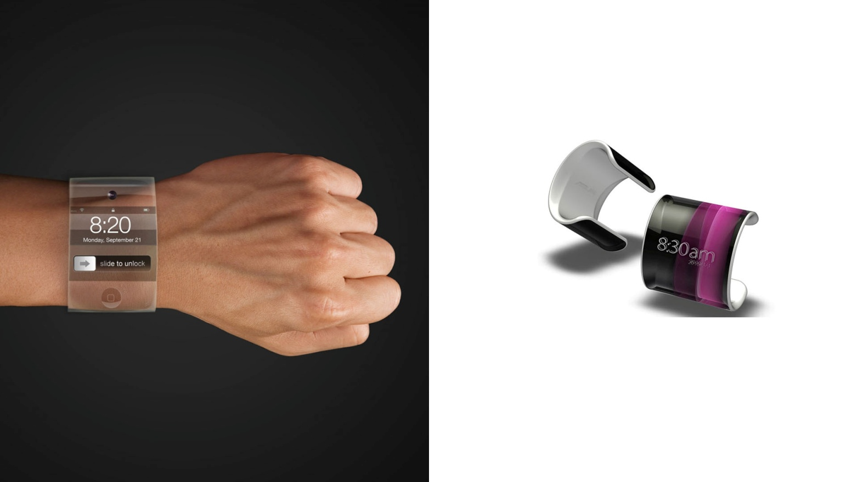
A glimpse into the future

Slide 9
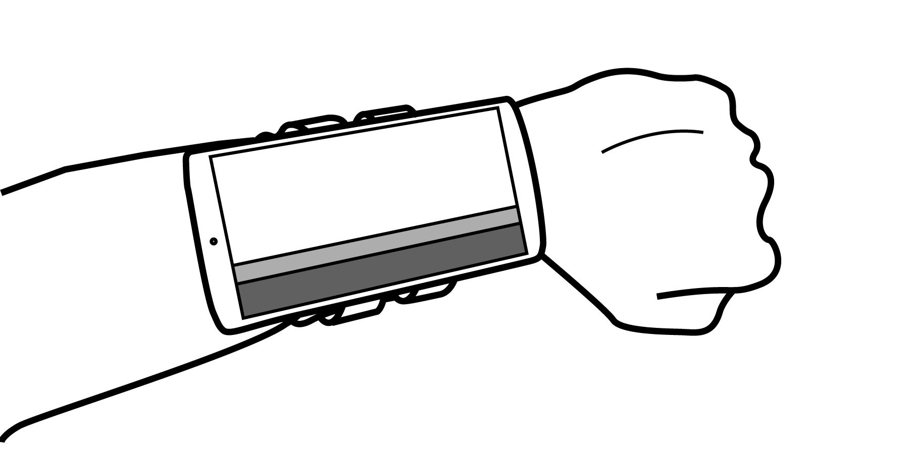
Our idea

Slide 10
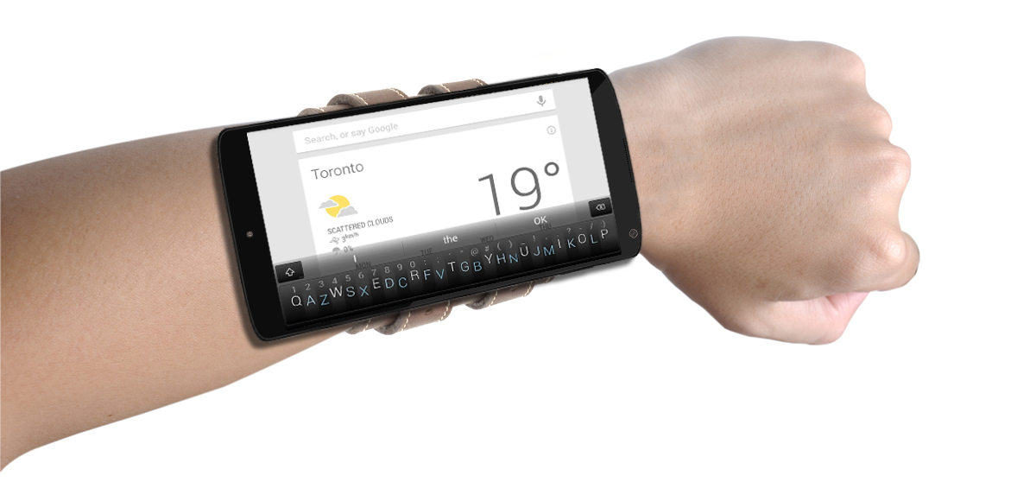
The concept

Slide 11
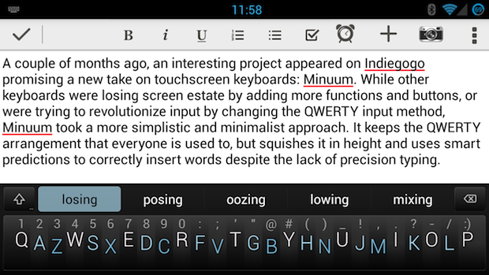
Key features

Slide 12
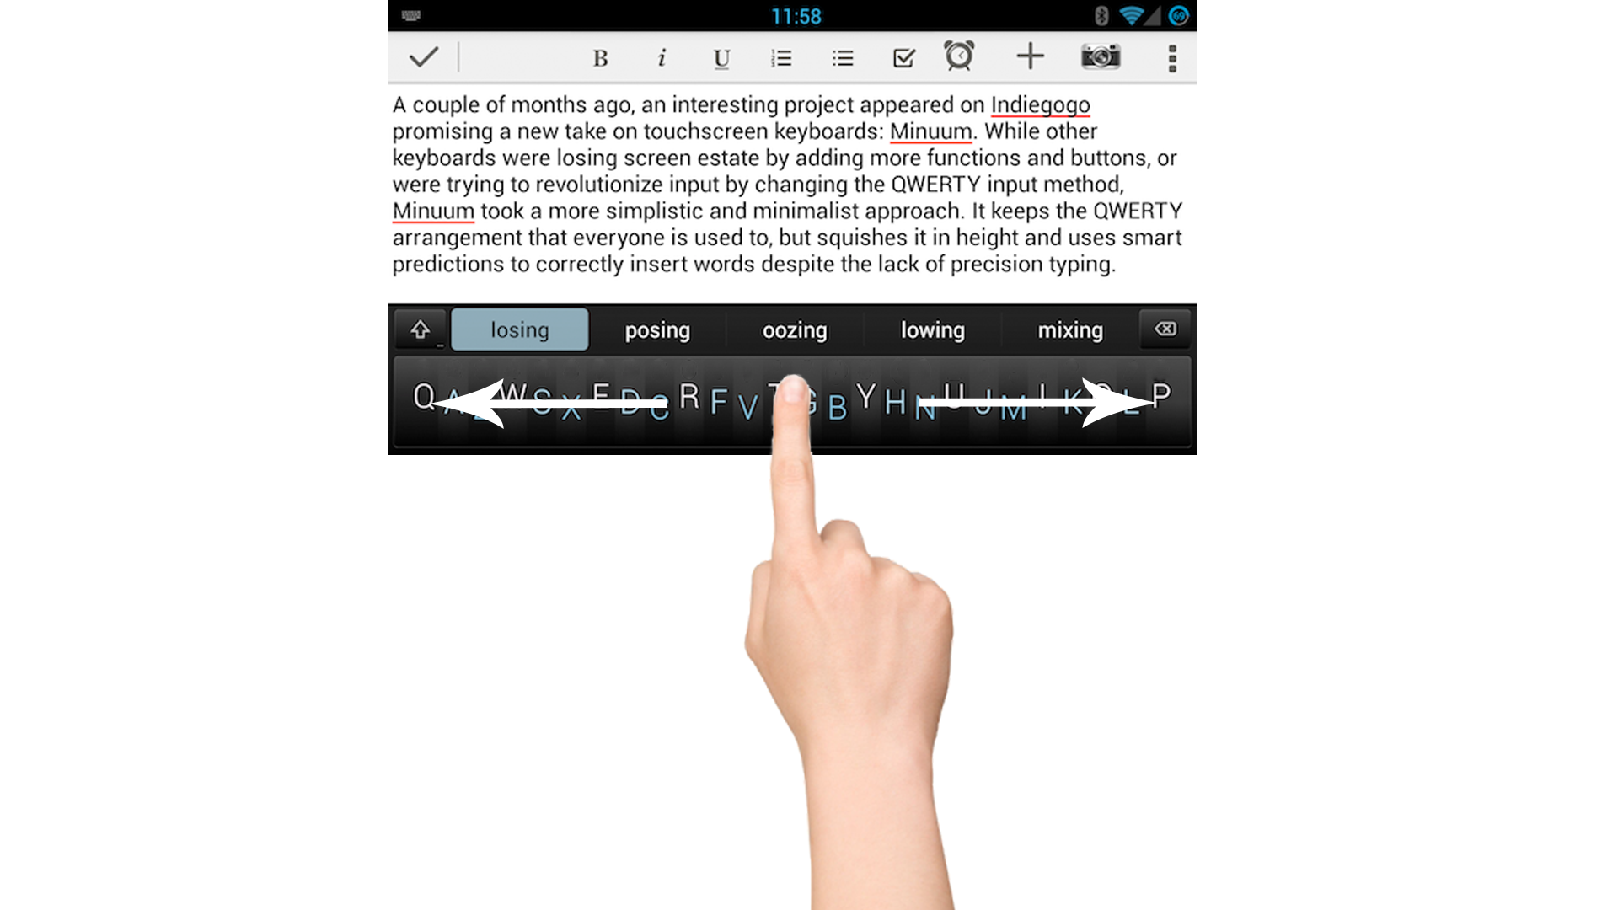
Key features

Slide 13
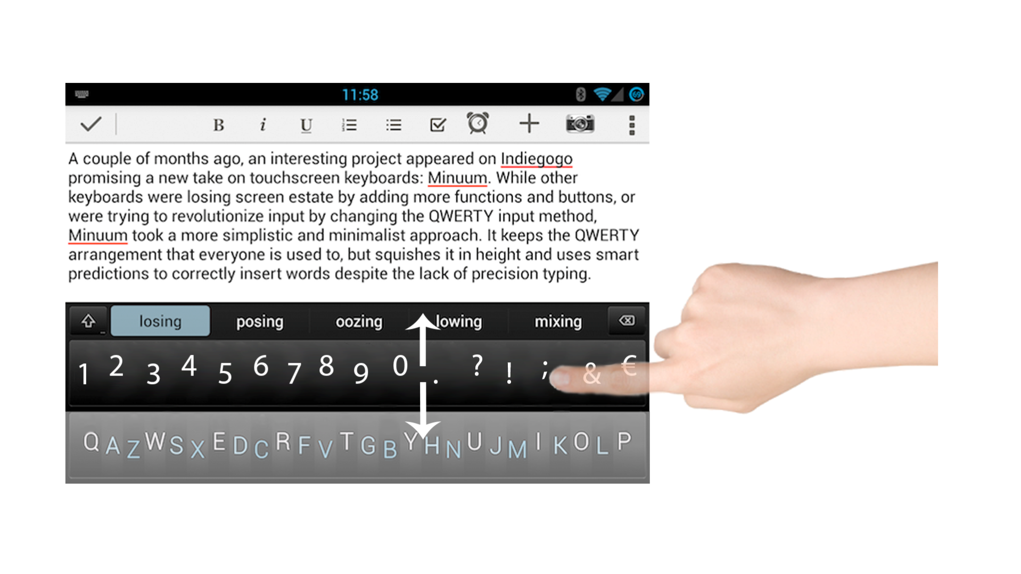
Key features

Slide 14

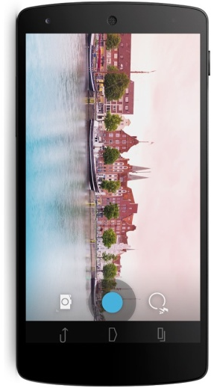
Implementation

Slide 15
Sources
http://philmckinney.com/wp/wp-content/uploads/2012/03/iStock_000016662401Medium.jpg
http://images.bwbx.io/cms/2013-01-28/0128_GWatch_630x420.jpg
http://www.technobuffalo.com/wp-content/uploads/2013/03/Google-Smartwatch-Concept.jpg
http://www.minuum.com
Let me google that for you …

